Slide 1
Mining Patterns in Source Code using Tree Mining Algorithms
Hoang Son Pham¹, Siegfried Nijssen¹, Kim Mens¹,
Dario Di Nucci², Tim Molderz², Coen De Roover²,
Johan Fabry³, and Vadim Zaytsev³
¹ ICTEAM, UCLouvain, Belgium
² Software Languages Lab, VUB, Belgium
³ Raincode Labs, Belgium
AIA meeting, 8th May, 2019

Slide 2
Outline
Introduction
Related work
Frequent tree mining background
Constraint-based maximal tree mining
Experimental results
Conclusion and future work

Slide 3
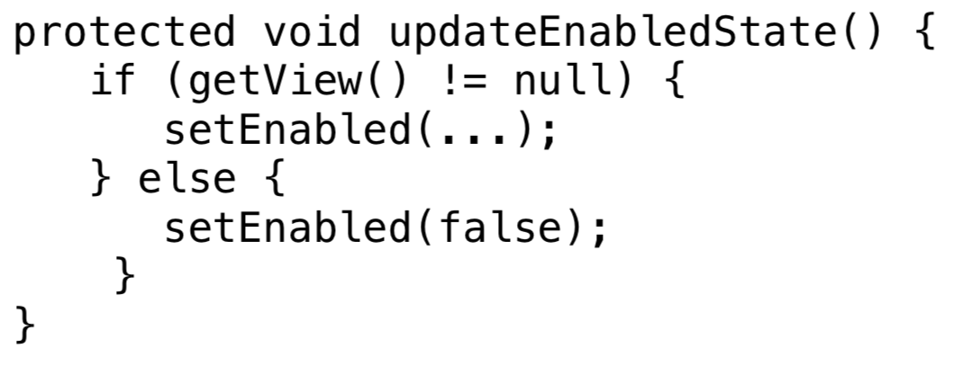
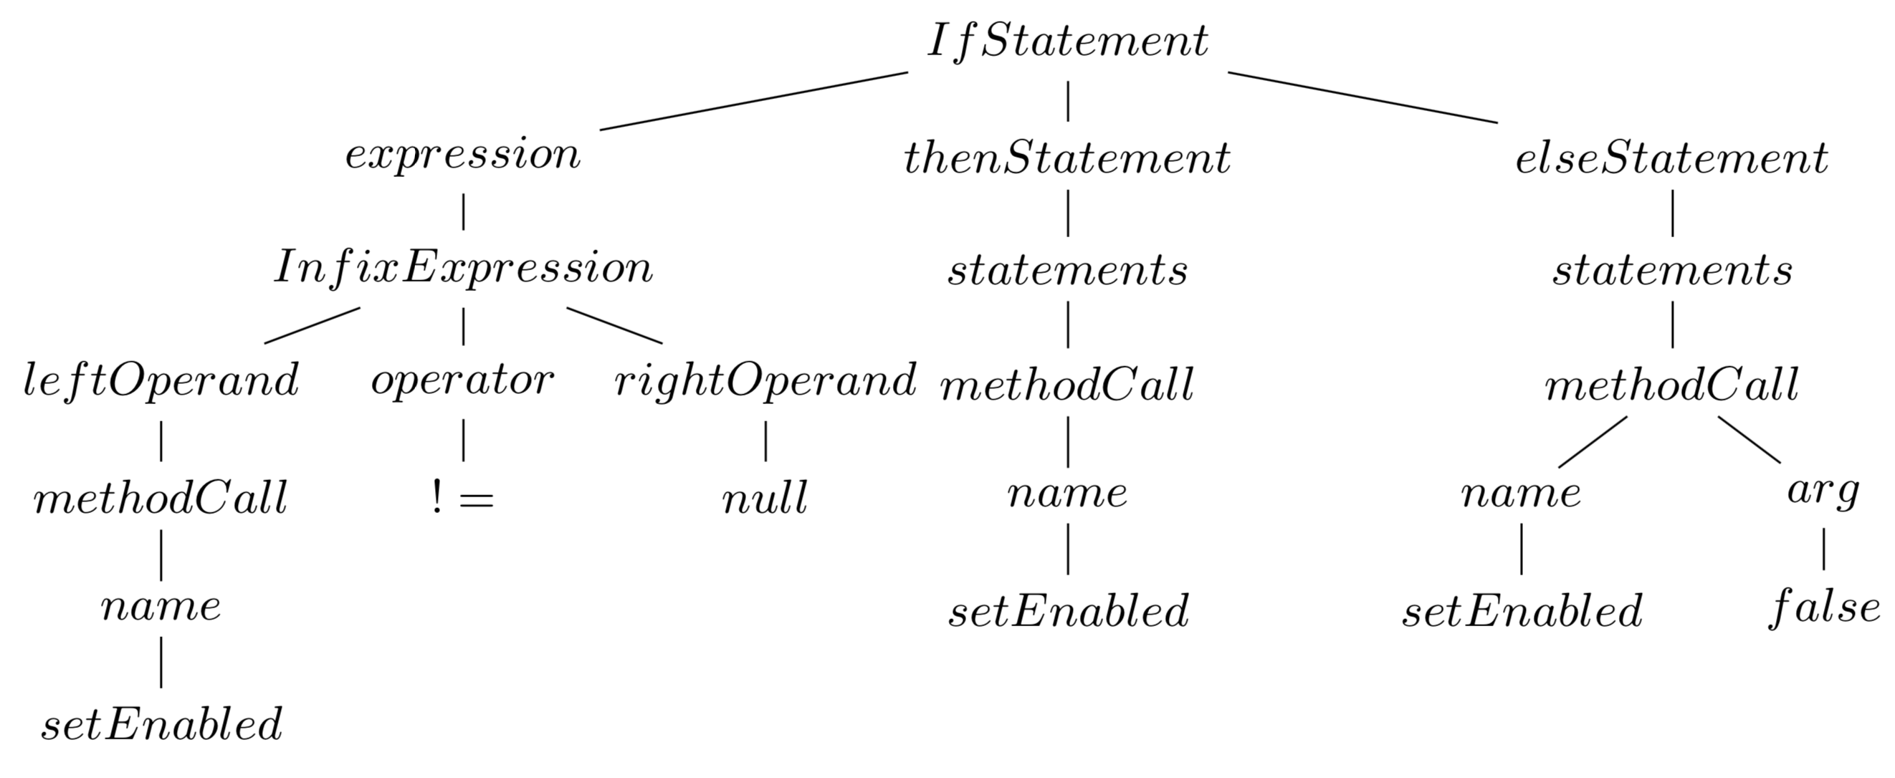
Introduction
Software source codes have structure
Regularities in source code: …
provide useful information for software engineers to ...
Fig.1. Source code
Fig.2. Abstract syntax tree

Slide 4
Related works
Related works
  Statistical methods
  Data mining methods
  Frequent tree mining methods
Remaining challenges:
  Output a large number of patterns
  Not useful patterns

Slide 5
Frequent tree mining

Slide 6
Constraint-based maximal tree mining
Imposed constraints
Combined constraints in maximal tree mining algorithm

Slide 7
Constraint-based maximal tree mining
Maximal subtree mining algorithm
  Step 1: find patterns under constraints
  Step 2:
    group pattern be root occurrences;
    grow found patterns as large as possible, and return maximal patterns among these large patterns

Slide 8
Constraint-based maximal tree mining
Constraints
  Minimum size constraints
  Constraints on labels
  Constraints on leafs
  Obligatory children

Slide 9
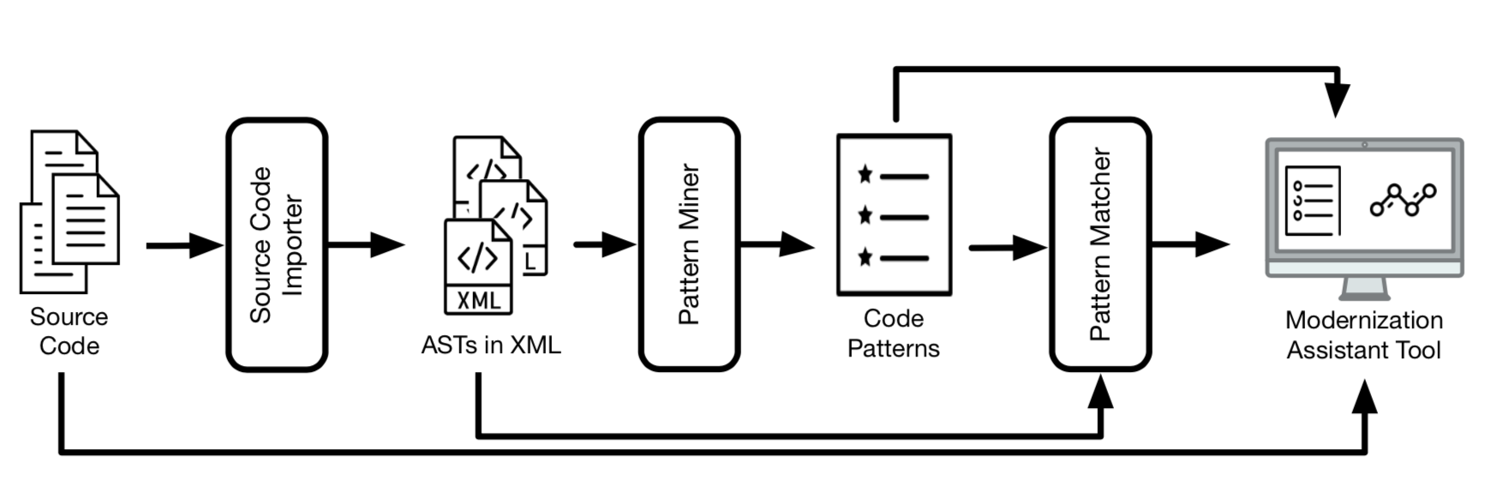
Experiments
The modular language-parametric framework for mining code regularities

Slide 10
Experiments
Experimental setup:
  Datasets:
  Configurations:

Slide 11
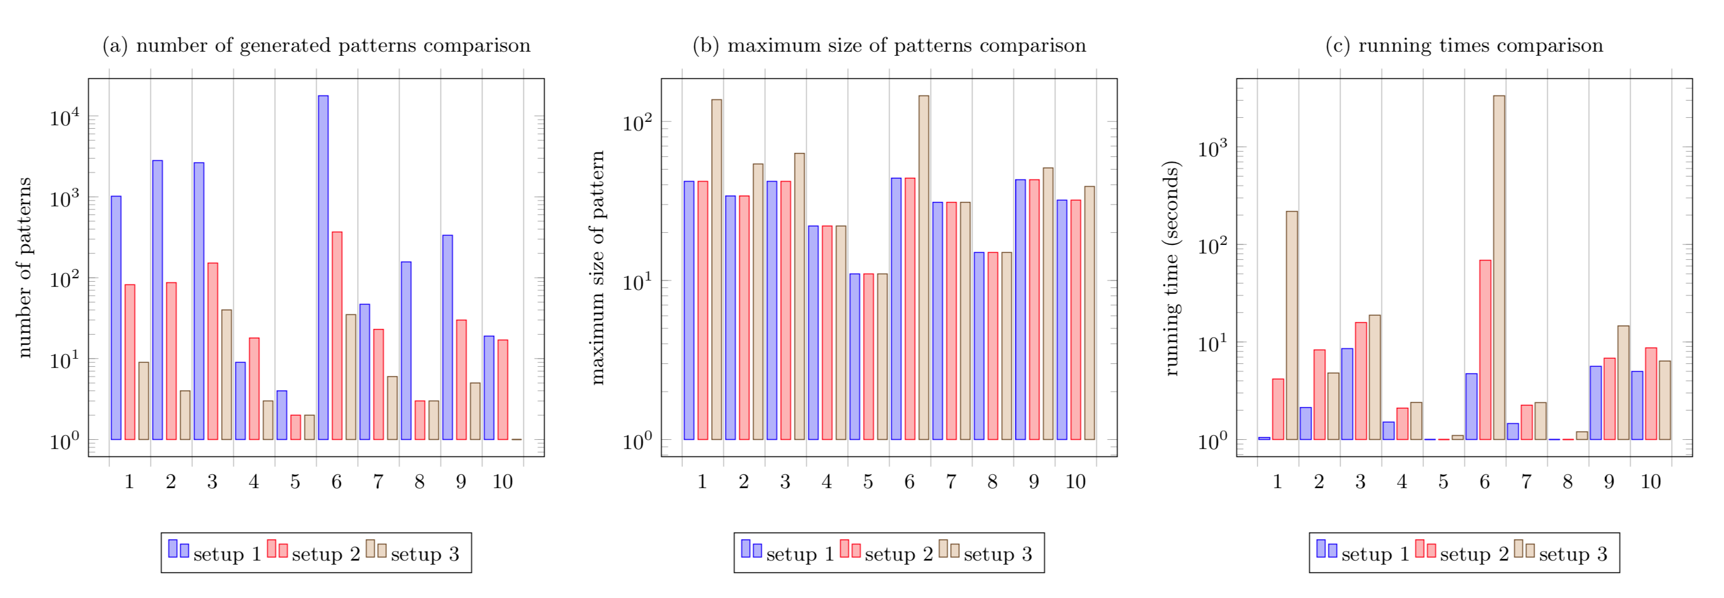
Experiments
Quantitative Analysis
Setup 1: original FREQT
Setup 2: extended FREQT with maximal size constraint
Setup 3: extended FREQT without maximal size constraint

Slide 12
Experiments
Qualitative Analysis

Slide 13
Conclusion and future work

